Slide 1
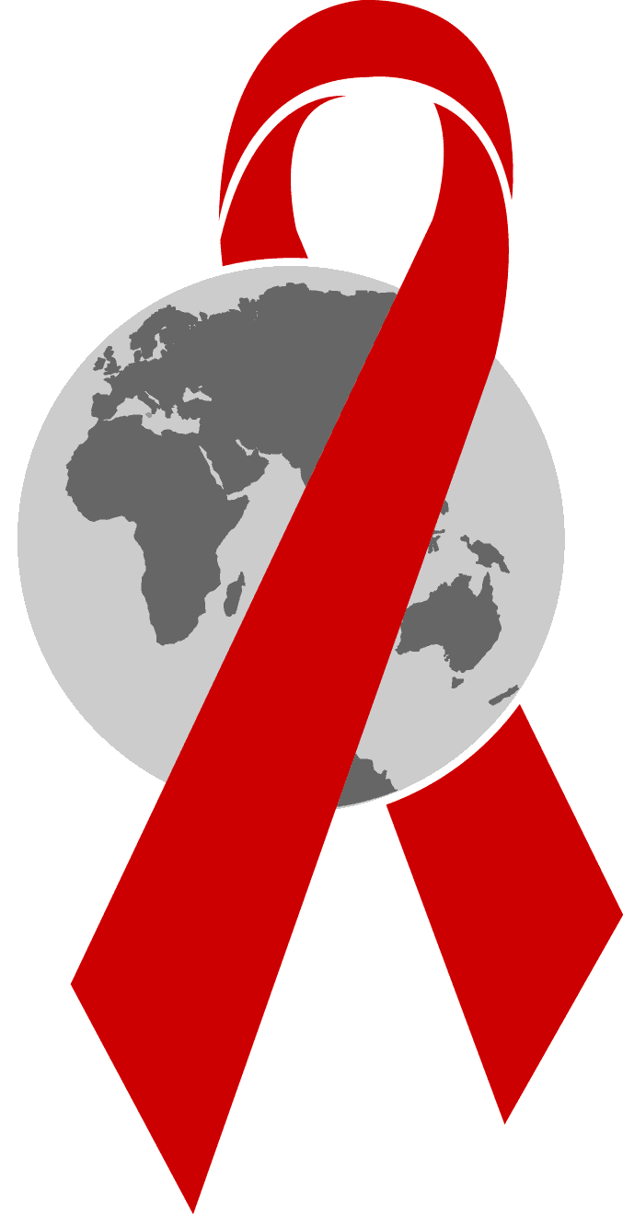
HIV/AIDS
DR. Afrin Ahmed Clara (AfC) SENIOR LECTURER, DEPARTMENT OF PUBLIC HEALTH SCHOOL OF HEALTH AND LIFE SCIENCE NORTH SOUTH UNIVERSITY

Slide 2
Global scenario
Number of people living with HIV | Adult | 38 milloin
 | Children <15 years | 1.8 million
 | Newly infected | 1.8 million 5000 new infection / day
Risk of developing TB in HIV patient 16-27 times greater than people without HIV infection PLHIV face the threat of drug-resistant TB. If diagnosis is delayed there is increased risk of mortality from multidrug-resistant and extensively drug-resistant TB.
TB is the leading cause of death among people with HIV, accounting for some 300,000 people who died from HIV-associated TB in 2017.

Slide 3
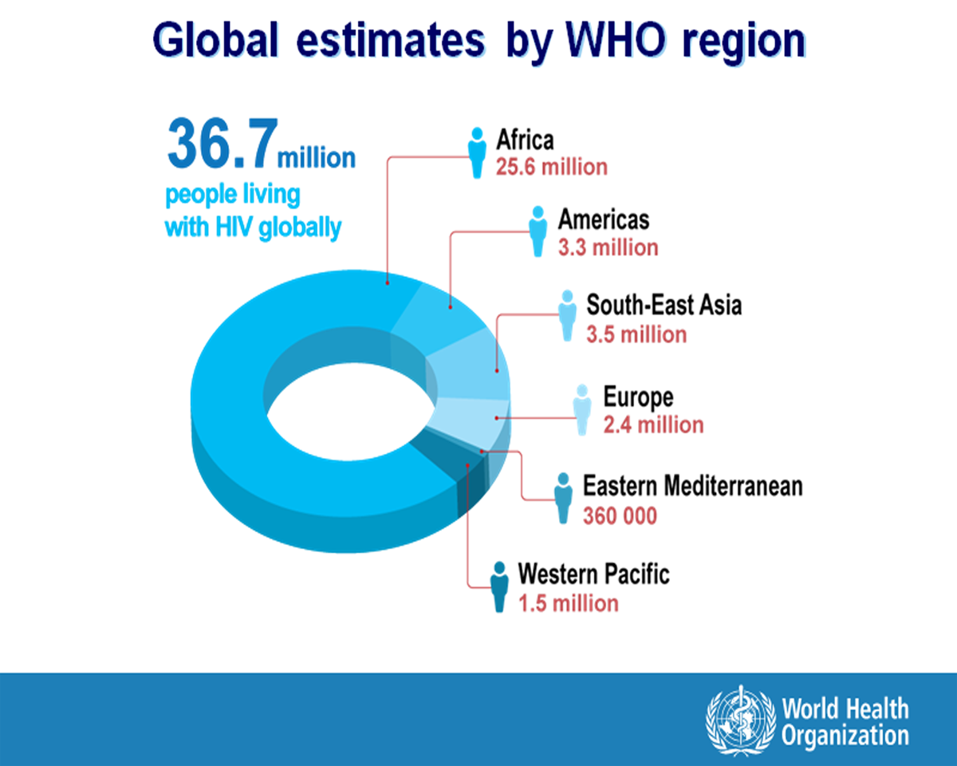

Slide 4
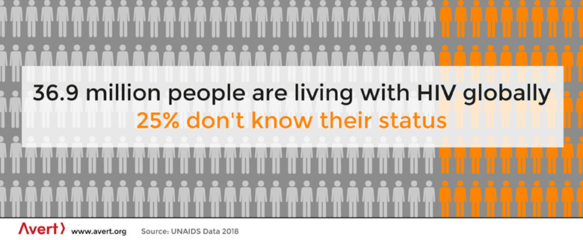

Slide 5
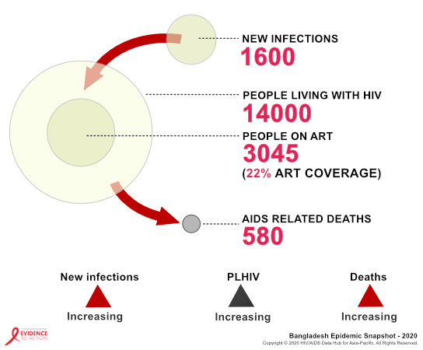

Slide 6


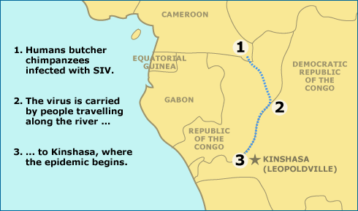

History
red-capped mangabeys
greater spot-nosed monkeys
The two different SIV strains then joined together to form a third virus (SIVcpz) that could be passed on to other chimps. This is the strain that can also infect human

Slide 7
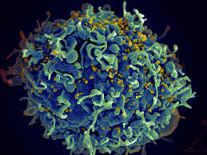
What is HIV ?
HIV means
Human Immunodeficiency Virus ( retrovirus that weakens immune system)
AIDS means
Acquired Immuno Deficiency Syndrome

Slide 8
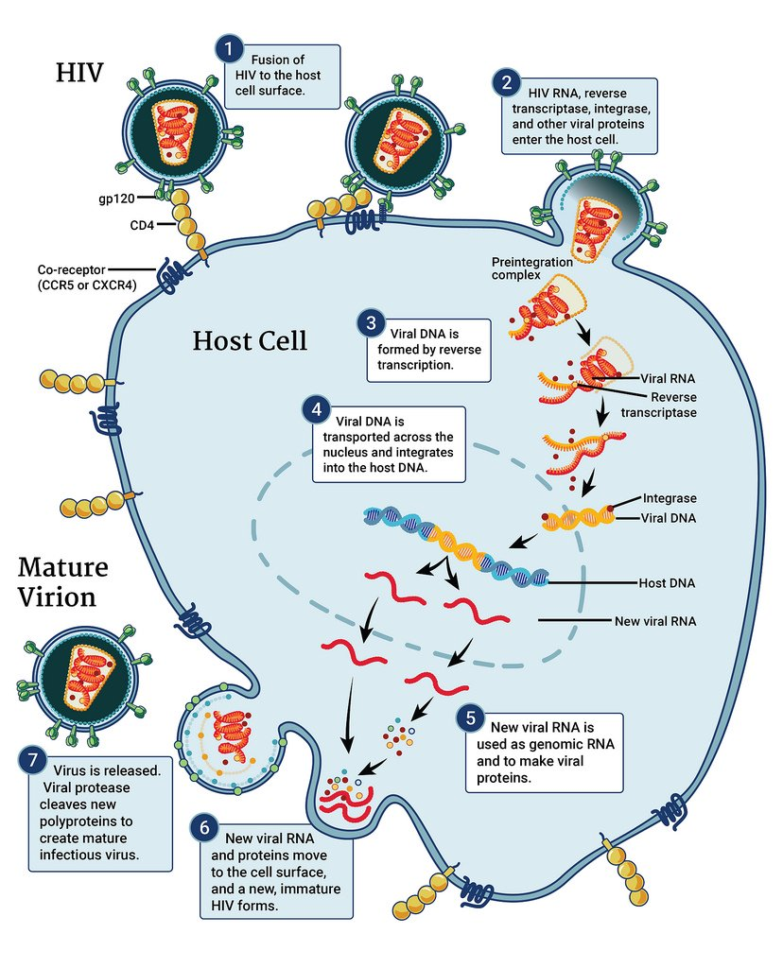
Virus attaches to cell
Part of it enters the cell
Virus gene integrates
Many viral parts manufactured
Viral parts are put together
New viruses leave the cell

Slide 9
Disease progression
AIDS and
Death
Primary
infection
Acute
Asymptomatic
(clinical latency)
CD8+ T cell
HIV viral load
Neutralizing Antibodies
Levels (Separate Scales)
CD4+ T cell
4 – 8
weeks
Years

Slide 10
When to do HIV test?
The window period is time between HIV infection and the point when the test will give an accurate result
During the window period a person can have HIV and be very infectious but still test HIV negative

Slide 11
These three types of diagnostic tests are used to detect HIV:
Antibody test. This test looks for the presence of HIV antibodies, or proteins that the body produces when an HIV infection is developing. Most HIV rapid tests and HIV home tests use antibody detection. A blood draw, finger prick, or oral swab may be used for this test.[ 23-90 days after an exposure]

Slide 12
Antigen/antibody tests. Antigens are substances that trigger the immune system when the HIV virus is in the acute infection stage. Antigens are released before antibodies are developed, so this type may be used for earlier detection. This test can also use a blood draw, finger prick, or oral swab.[ 18 -90 days after an exposure]

Slide 13
Nucleic acid amplification test (NAAT). An expensive option, a NAT can search for the virus genetic material itself in blood samples. This test is typically saved for confirming a positive diagnosis or for people with a high risk of exposure or several known risk factors. A NAT typically uses a blood sample or an oral swab taken from the inside of the cheek. [10-33 days after exposure]
RNA PCR- 3 Days to 4 weeks

Slide 14
What does this mean for me?
For most people, the best time to test is 3 weeks after having unprotected (condomless) sex with a new partner. If the test is negative, there is a good chance you do not have HIV from that sexual contact.
If you test at 6 weeks after having unprotected (condomless) sex with a new partner, and that test is negative, there is a 99% chance you do not have HIV from that sexual exposure.
With any HIV test, you should test again at 3 months to be sure.
Because HIV and other sexually transmitted infection (STI) rates are high in gay, bisexual and other men who have sex with men, routine screening every 3 months is recommended.

Slide 15

OPPURTUNISTICS INFECTIONS are infections that occur more often or are more severe in people with weakened immune systems than in people with healthy immune systems. People with weakened immune systems include people living with HIV or people receiving chemotherapy.
Once a person is infected with HIV, the virus begins to multiply and to damage the immune system. A weakened immune system makes it harder for the body to fight off HIV-related OIs.

Slide 16
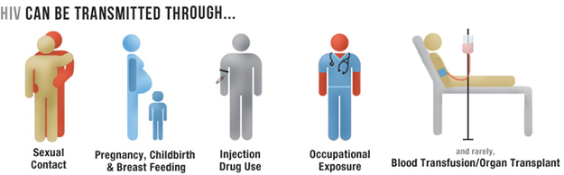
How HIV passed from one person to another
Unprotected sex with HIV infected person– Vaginal or Anal ( Anal sex is the highest risk sexual behavior for HIV )
Sharing needles or syringes with HIV positive person
Blood transfusion from HIV patient
From HIV positive mother to child
Through breast milk

Slide 17
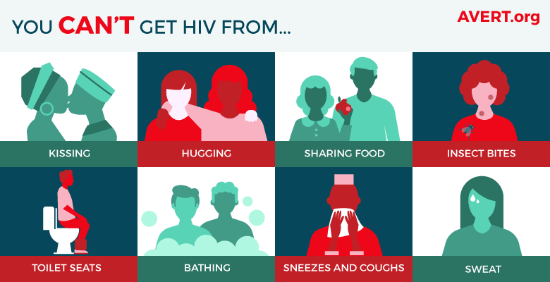

Slide 18
HIV not spread through
Casual / social contact
Kissing and hugging
Mosquito bites
Using same utensils / towels, etc.
Sharing the same wash-rooms
By touching items that were touched by an infected person

Slide 19
HIV is found in
HIV lives and reproduces in blood and other body fluids. We know that the following fluids can contain high levels of HIV:
Blood
Semen
Pre-seminal fluid
Breast milk
Vaginal fluids
Rectal (anal) mucous
Healthcare workers may be exposed to some other body fluids with high concentrations of HIV, including:
Amniotic fluid
Cerebrospinal fluid
Synovial fluid

Slide 20
Stages of HIV
Acute HIV infection stage
Fever, swollen glands, sore throat
Muscle and joint pain, headache
Clinical latency
1-10 YEARS
AIDS
a person with HIV must have an AIDS-defining condition or have a CD4 count less than 200 cells/mm³

Slide 21
Risks and vulnerabilities
HIV prevalence among IDUs in Dhaka city is 5.3%
Unprotected commercial sex, MSM, Multiple partner
low rate of condom use
Geographical vulnerability ( Cross border with India and Myanmar)

Slide 22
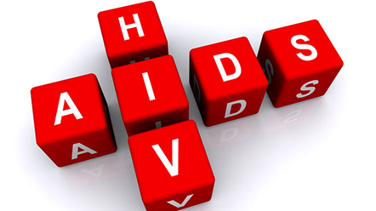
AIDS
A disease of the immune system due to infection with HIV. HIV destroys the CD4 T lymphocytes (CD4 cells) of the immune system, leaving the body vulnerable to life-threatening infections and cancers. Acquired immunodeficiency syndrome (AIDS) is the most advanced stage of HIV infection. To be diagnosed with AIDS, a person with HIV must have an AIDS-defining condition or have a CD4 count less than 200 cells/mm³ (regardless of whether the person has an AIDS-defining condition).

Slide 23
If AIDS does develop, it means that the immune system is severely compromised. It’s weakened to the point where it can no longer fight off most diseases and infections. That makes the person vulnerable to a wide range of illnesses, including………..

Slide 24
Pneumonia
Tuberculosis
Oral thrush, a fungal infection in the mouth or throat
Cytomegalovirus (CMV), a type of herpes virus
Cryptococcal meningitis, a fungal infection in the brain
Toxoplasmosis, a brain infection caused by a parasite
Cryptosporidiosis, an infection caused by an intestinal parasite
Cancer, including Kaposi’s sarcoma (KS) and lymphoma

Slide 25
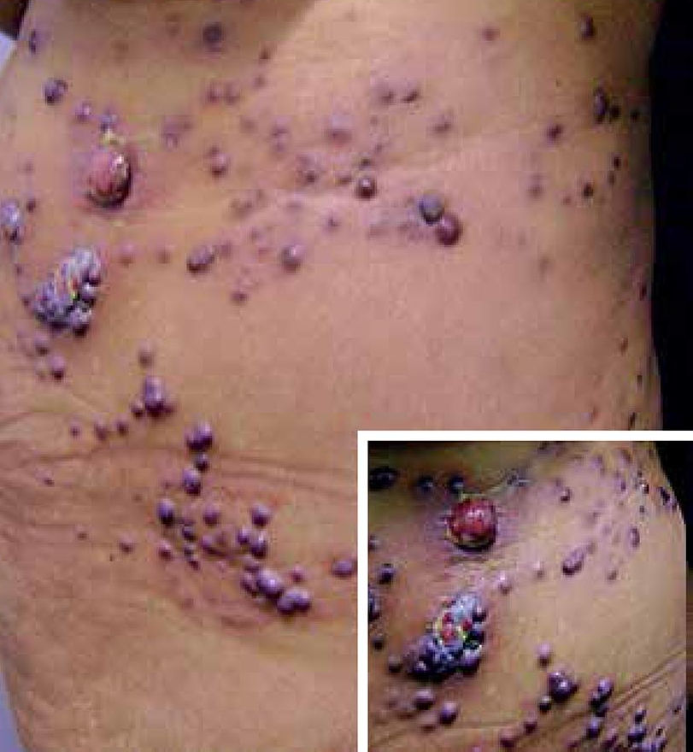
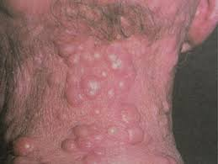
AIDS
NEOPLASM
Kaposi’s sarcoma
Lymphoma

Slide 26
Bacteria
S pneumonia
Spesis
Pneumonia
Meningitis
M Avuim intracellulare
Viruses
Epstein barr virus
Cytomegalovirus
Varicella zoster
Fungal
Pneumocystis jiroveci
Candida
Cryptococcus neoformans
Protozoa
Toxoplasma gondii –
Cerebral abscess –
Retinitis

Slide 27
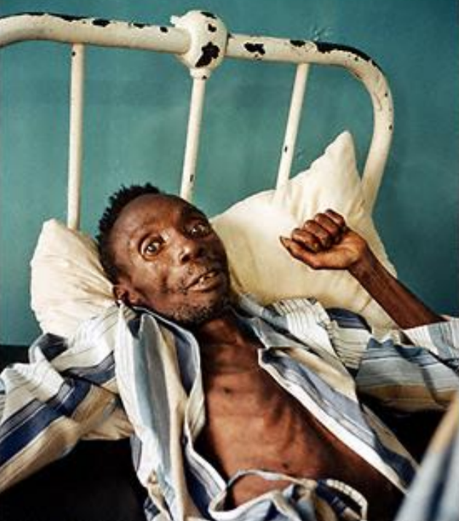
HIV (direct effect) – Enteropathy
Dementia
Nephropathy

Slide 28
Prevention
Male and female condom use
Correct and consistent use of male and female condoms during vaginal or anal penetration can protect against the spread of sexually transmitted infections, including HIV. Evidence shows that male latex condoms have an 85% or greater protective effect against HIV and other sexually transmitted infections (STIs).
2. Testing and counselling for HIV and STIs
Testing for HIV and other STIs is strongly advised for all people exposed to any of the risk factors
3. Testing and counselling, linkages to tuberculosis care
Early detection of TB and prompt linkage to TB treatment and ART can prevent these deaths

Slide 29
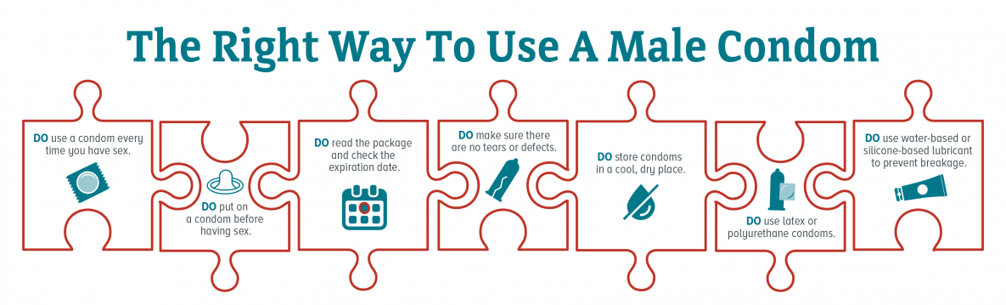

Slide 30
4. Voluntary medical male circumcision (VMMC)
Medical male circumcision, reduces the risk of heterosexually acquired HIV infection in men by approximately 60%.
5. Antiretroviral drug use for prevention
a) Prevention benefits of ART
A 2011 trial has confirmed that if an HIV-positive person adheres to an effective ART regimen, the risk of transmitting the virus to their uninfected sexual partner can be reduced by 96%. The WHO recommendation to initiate ART in all people living with HIV will contribute significantly to reducing HIV transmission.

Slide 31
b) Pre-exposure prophylaxis (PrEP) for HIV-negative partner
WHO recommends PrEP as a prevention choice for people at substantial risk of HIV infection as part of a combination of prevention approaches. WHO has also expanded these recommendations to HIV-negative women who are pregnant or breastfeeding.
c) Post-exposure prophylaxis for HIV (PEP)
Post-exposure prophylaxis (PEP) is the use of ARV drugs within 72 hours of exposure to HIV in order to prevent infection.

Slide 32
You must start PEP within 72 hours after you were exposed to HIV, or it won’t work. Every hour counts.
If you are prescribed PEP, you will need to take the HIV medicines every day for 28 days.
PEP is effective in preventing HIV infection when it’s taken correctly, but it’s not 100% effective. The sooner you start PEP after a possible HIV exposure, the better.
While taking PEP, it’s important to keep using other HIV prevention methods, such as using condoms the right way every time you have sex and using only new, sterile needles and works when injecting drugs.

Slide 33




Celebrities with AIDS

Slide 34
http://aphub.unaids.org/

Slide 35
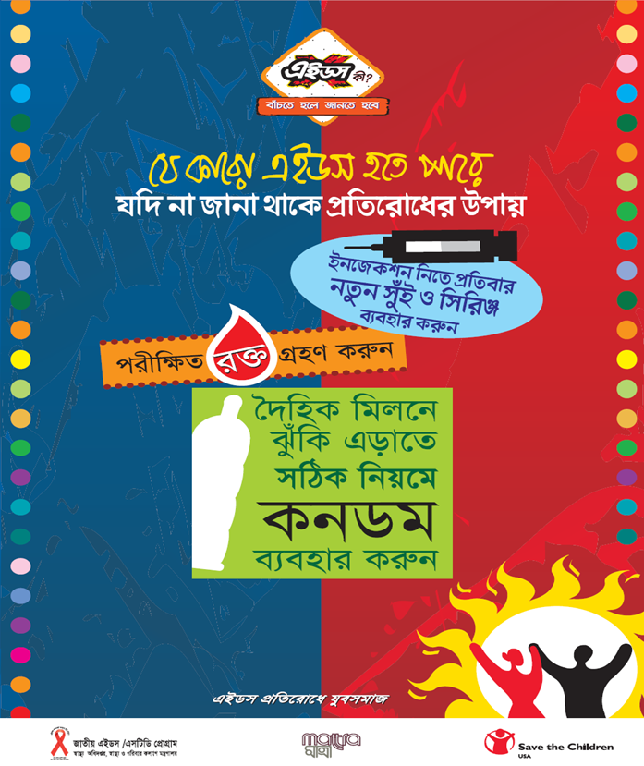
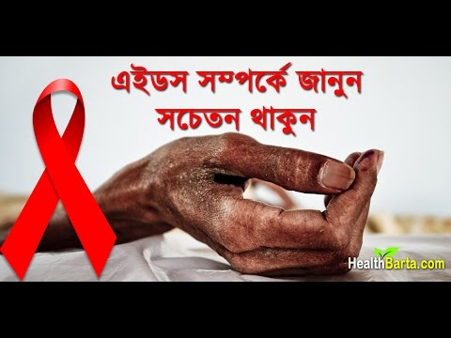

Slide 36

Thanks

